Slide 1
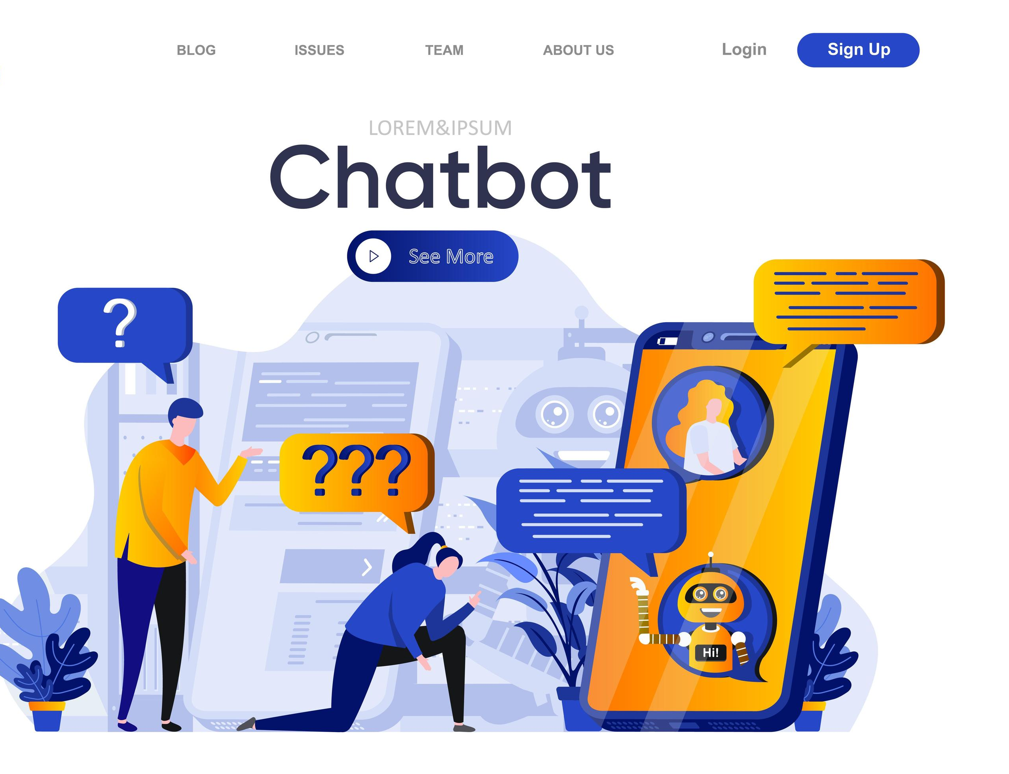
FINAL PROJECT BAM 3034 - Sentiment Analysis and Text Mining
Group Members:
Harmeet Singh (c0892997)
Harshita Harshadbhai Shiroya (c0894233)
Mihir Bhagvanbhai Chaudhary (c0893689)
Nikitha Mummidi (c0896336)
Swetha Sara Abraham (c0902578)
Tanvi Dhirajbhai Patel (c0907214)

Slide 2
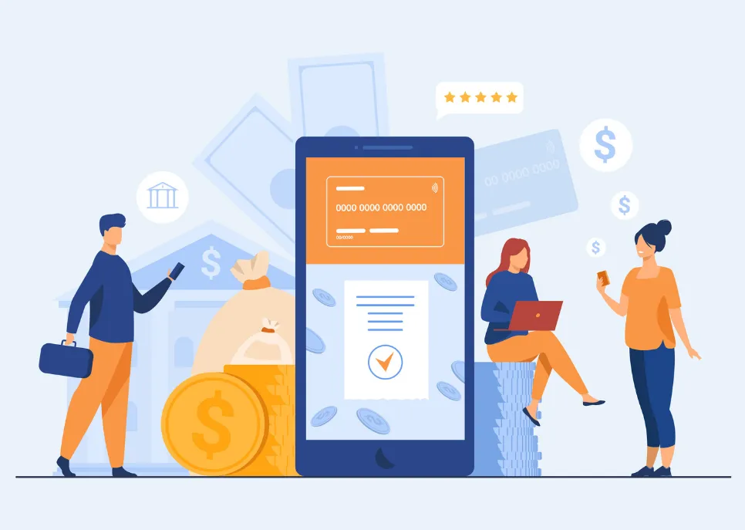
PROBLEM
In banking, chatbots solve numerous business problems by enhancing customer service efficiency, reducing operational costs, and improving user experience through personalized interactions.
They provide 24/7 support, handle routine inquiries, assist with financial advisory and planning, and streamline onboarding and account management.
Additionally, chatbots aid in lead generation, fraud detection, regulatory compliance, and employee internal support.
By automating these tasks, banks can focus on more complex customer needs, thus increasing customer satisfaction and loyalty while ensuring operational efficiency and cost savings.

Slide 3
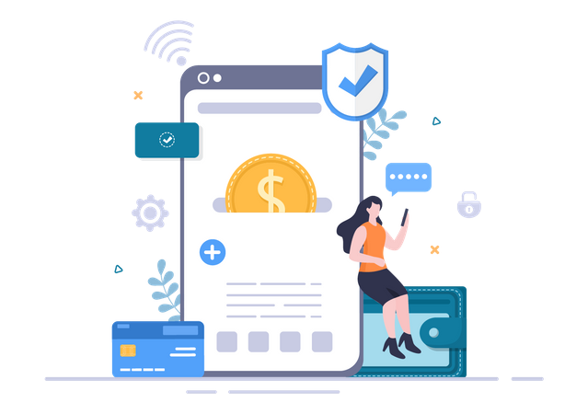
Financial Viability
Cost Reduction
Improved Efficiency
Enhanced Customer Experience
Revenue Generation
Fraud Detection and Prevention
Regulatory Compliance
Long-Term Savings

Slide 4
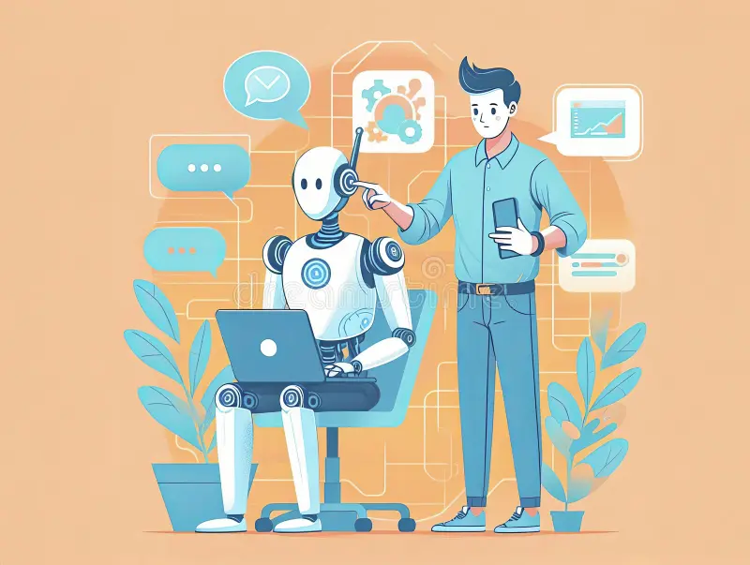
Main NLP Concepts
Intent Recognition
Entity Extraction
Context Management
Dialog Management
Natural Language Generation (NLG)

Slide 5
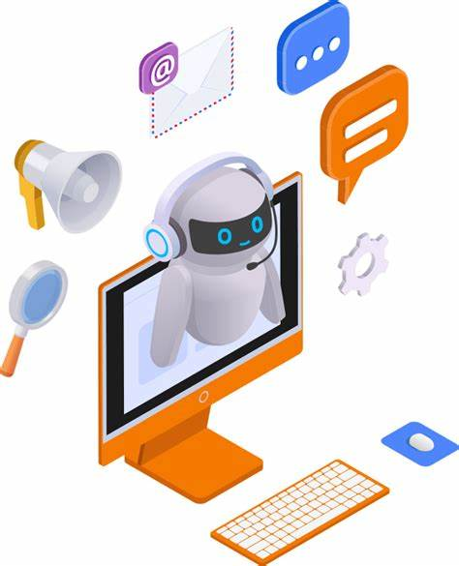
Future Work and Enhancements
Enhanced Personalization
Voice Integration
Advanced Fraud Detection
Multilingual Support

Slide 6
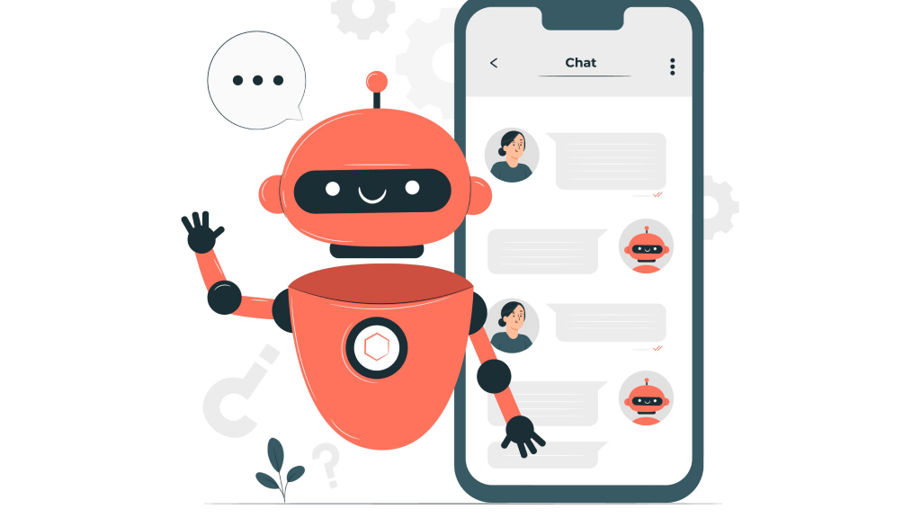
REFERENCES
https://www.coursera.org/articles/what-is-a-chatbot?utm_medium=sem&utm_source=gg&utm_campaign=B2C_NAMER__coursera_FTCOF_career-academy_pmax-enhanced-NRL-w/in-14d-new-cust-country-US-country-CA&campaignid=20397118025&adgroupid=6490599411&device=c&keyword=&matchtype=&network=x&devicemodel=&adposition=&creativeid=6490599411&hide_mobile_promo&gad_source=1&gclid=Cj0KCQjwh7K1BhCZARIsAKOrVqFdqVhupxblBoZUd7PdpZBsFnHZF9L-r8gmusMUWB868EfVCbfYqgAaAolFEALw_wcB
https://realpython.com/build-a-chatbot-python-chatterbot/
https://www.irjet.net/archives/V10/i5/IRJET-V10I575.pdf
https://tovie.ai/blog/banking-chatbots-examples-and-best-practices-for-implementation
https://yellow.ai/blog/chatbots-in-banking/#:~:text=How%20do%20banking%20chatbots%20work,as%20balance%20inquiries%20and%20transactions.

